Slide 1


Claudion.com
The Cloud Solution built for Saudi Businesses
Host your private cloud server in Riyadh or Jeddah with full control, privacy, and security.
Seamlessly integrate with ZATCA e-invoicing, payment gateways, government services, and more.

Slide 2
Hosted in Riyadh and Jeddah, and on FrappeCloud
Fully compliant with Zatca Phase-2 Einvoicing
Why Claudion.com?
To be legally compliant, fast, safe and secure. Dedicated servers for each client, with full control and portability.
Hundreds of companies Submitting thousands of invoices to ZATCA using claudion
Ready to use ERP and CRM
Integrate “anything” in Saudi
Ready to use Accounting, sales & inventory modules. Along with CRM, Helpdesk, Call center add-ons
Integration with Saudi services: Payment gateways, govt services, shopping platforms, WhatsApp, SMS, call centers, and more.

Slide 3

Claudion
is developer friendly
DEVELOPER FRIENDLY
We provide full backend for app developers, so they can reduce development time by up to 90%. Also we share code with your developers.
Claudion helps developers to integrate with any service provider in KSA.

Slide 4
Direct Invoice submission from ERP system
Offline-POS
Generate invoices in remote branches, including QR codes as per ZATCA guidelines. Sync with your cloud server anytime.
ZATCA Phase-2 options
Presentations are communication tools.
Online POS
Submit fromThird-party systems
Work on Branches and outlets online with direct submission to Zatca, using Claudion as central server
Submit through Excel or API. Use our standard Excel/CSV formats, or get custom formats with our developer support.

Slide 5
Onboarding support
OUR TEAM WILL HELP YOU TO ONBOARD WITH ZATCA
Onboarding to Zatca system, creating certificates, printing QR Codes, sync offline system, creating excel format etc often need expert support. Our experienced team will support you on that process will continue support whenevery you need.

Slide 6
Payment gateways
Govt and Insurance systems
Claudion will help you to Seamlessly integrate with any payment sytem or credit card machines in Saudi Arabia
Integration for Saudi
Our team will help you to integrate your system with Goverment service and insurance companies.
Shopping portals
Whatsapp, SMS, Call centers
Our team will support you to integrate with shopping portals like Amazon, Noon, Shoppify and more
We work closely with SMS, Whatsapp and call-center service providers in Saudi Arabia to help our client to integrate.

Slide 7
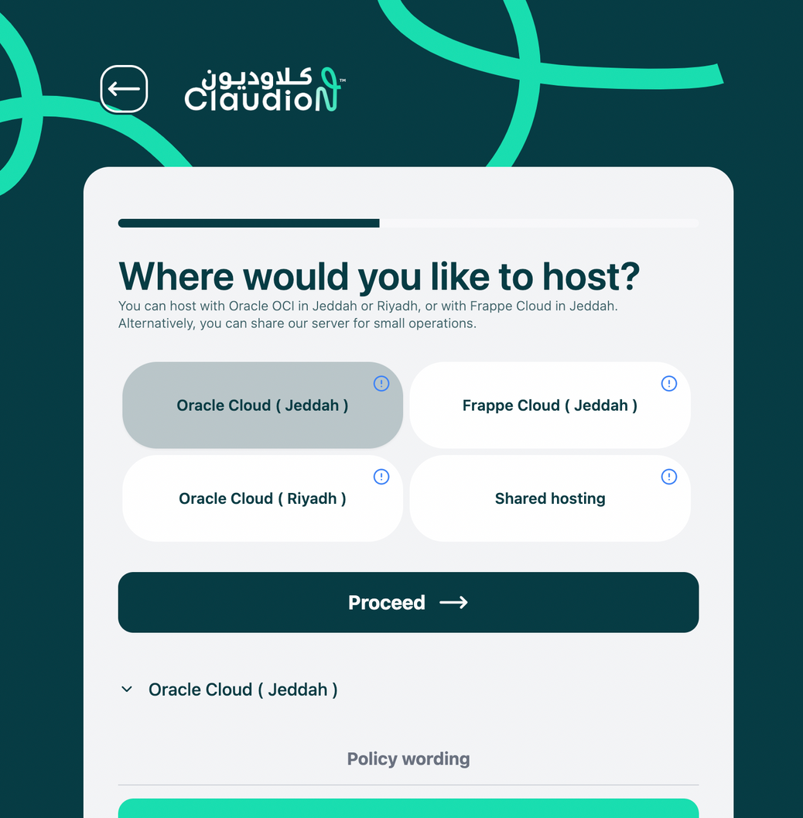
BUILD YOUR SERVER
You can build your server through our portal Claudion.com
Our team will support you on onboarind and integration process
https://saudi.claudion.com/onboarding

Slide 8
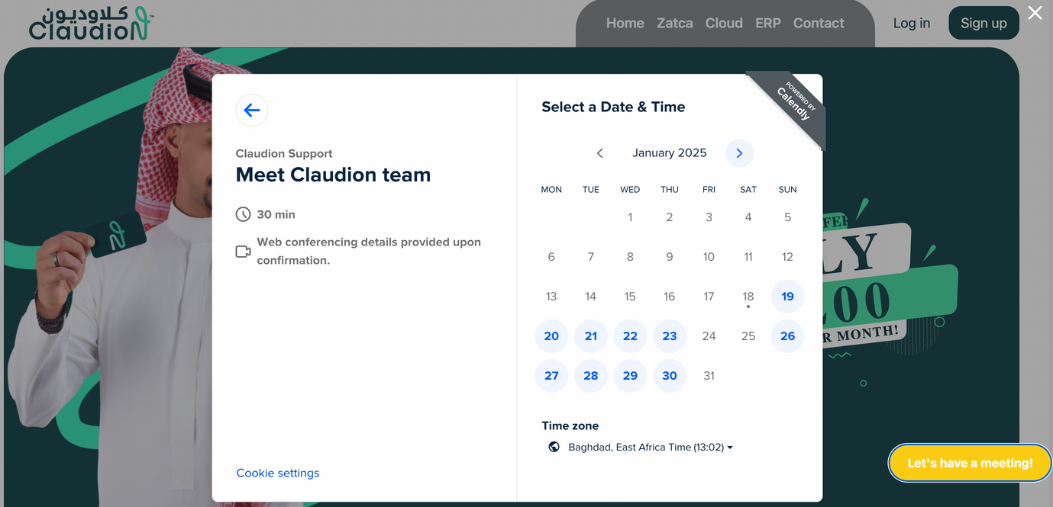
Let’s talk
DID YOU
KNOW?
Let’s discuss how to build a system that works for your company in Saudi Arabia
Schedule a meeting with this link
https://calendly.com/claudion-support/30min

Slide 9
The Cloud Solution built for Saudi Businesses
Claudion.com
Contact us on info@Claudion.com

